Slide 1

Freshco Hypermarket
- By Vipul Jain

Slide 2

Insights and Observation Report Of 2021

Slide 3
Key Insights:
Rapid Growth in Specific Areas: Areas like HSR Layout, ITI Layout, and Koramangala are experiencing significant growth, likely driven by increased orders and aggressive discounting strategies. This indicates these regions are becoming key markets for expansion.
Strategic Shift in Discounting and Delivery: The company appears to be shifting its focus from lower delivery charges to offering higher discounts, particularly in competitive or high-growth areas. This strategy is aimed at customer acquisition, retention, and increasing order frequency, helping to establish a stronger market presence.
Time Slot and Order Size Impact on Completion and Ratings: Afternoon and evening time slots show high completion rates, with larger orders (3-7 items and 18-24 items) receiving the highest ratings. This suggests a focus on optimizing these time slots and order sizes could enhance customer satisfaction and operational efficiency.
Regional Variations in Delivery Challenges: Some regions like Brookefield face logistical challenges with high delivery charges and long times, while areas like HSR Layout and Bellandur Ecospace demonstrate efficient logistics with low charges and quick deliveries. Addressing these disparities can help improve overall service consistency.

Slide 4


Order Level Analysis

Slide 5
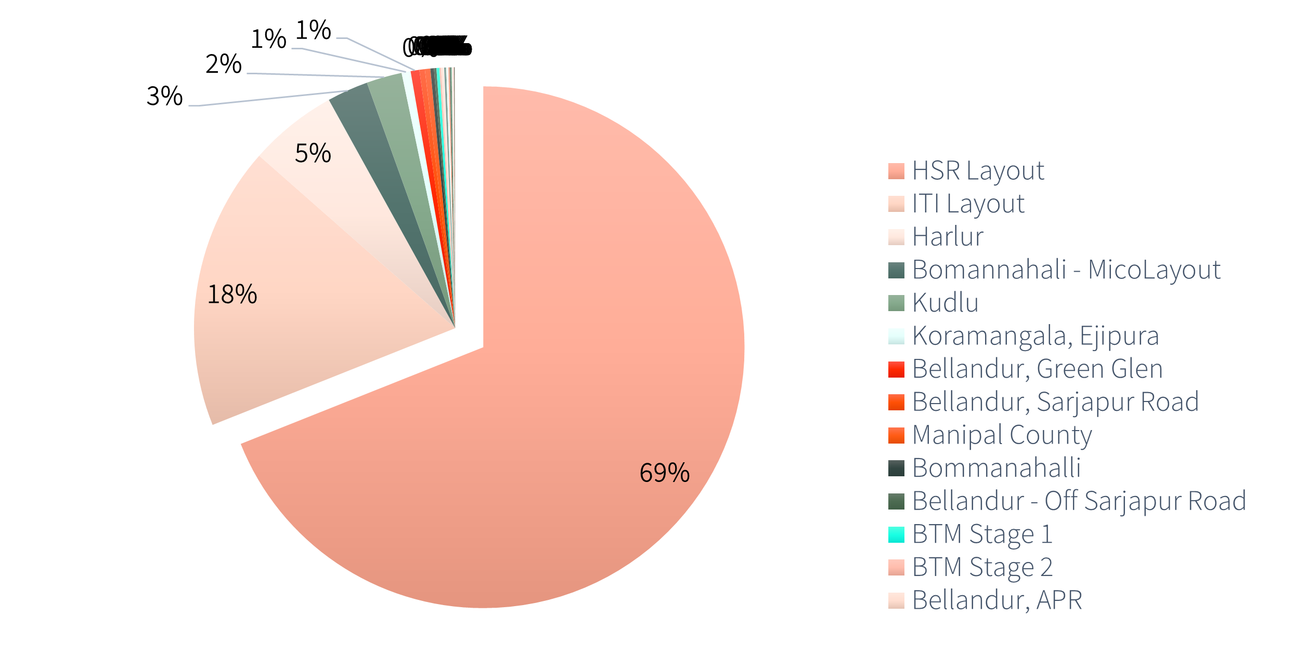
Order Distribution Amongst Different Areas of Bangalore in 2021
Areas | Count of Orders
HSR Layout | 15657
ITI Layout | 3946
Harlur | 1309
Bomannahali - MicoLayout | 551
Kudlu | 518
Koramangala, Ejipura | 160

Slide 6
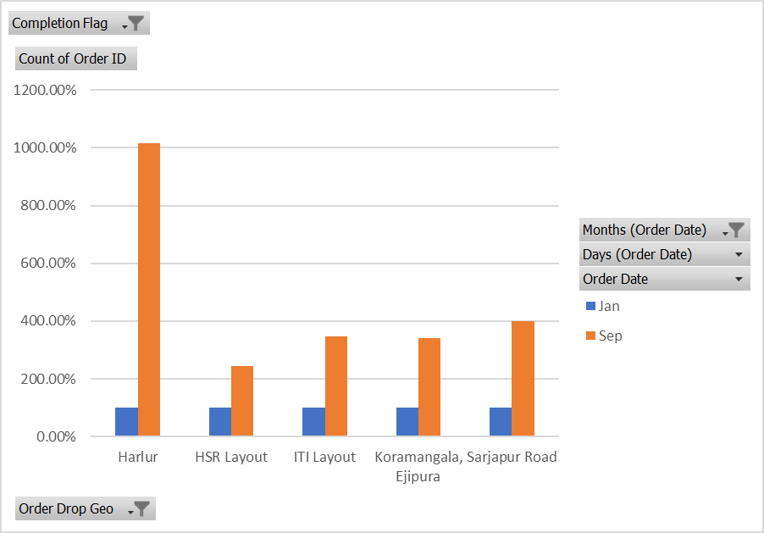
Areas Showing Maximum Growth Between January and September
Areas | Orders(Jan) | Orders(Sept)
Harlur | 100.00% | 1015.09%
HSR Layout | 100.00% | 243.70%
ITI Layout | 100.00% | 348.29%
Koramangala, Ejipura | 100.00% | 340.00%
Sarjapur Road | 100.00% | 400.00%

Slide 7
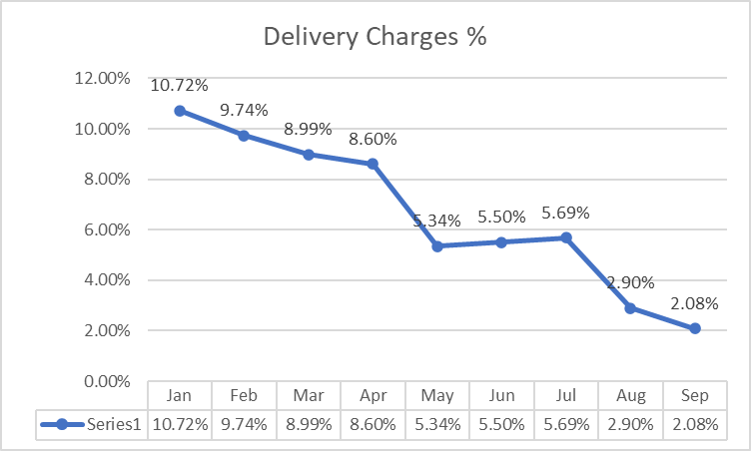
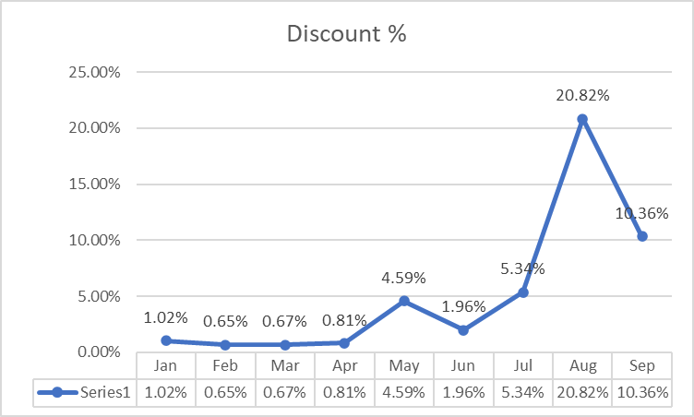
Delivery Charges and Discounting Strategy

Slide 8
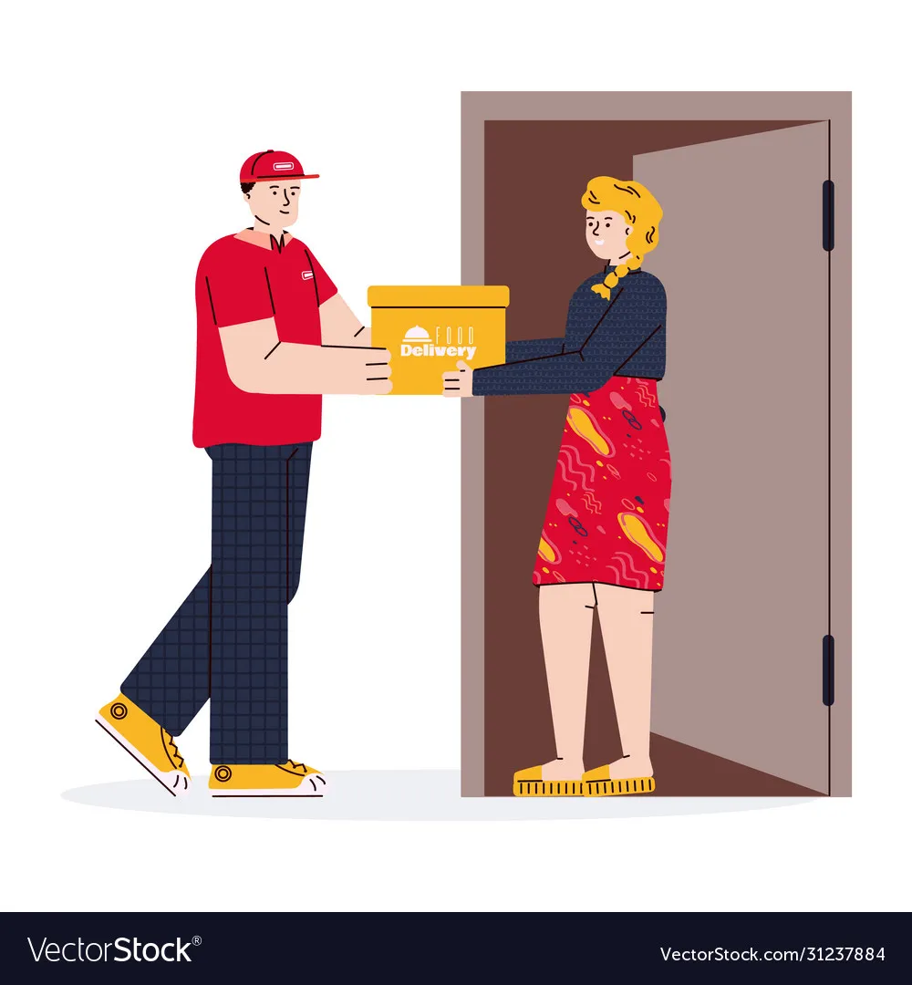

Completion Rate Analysis

Slide 9
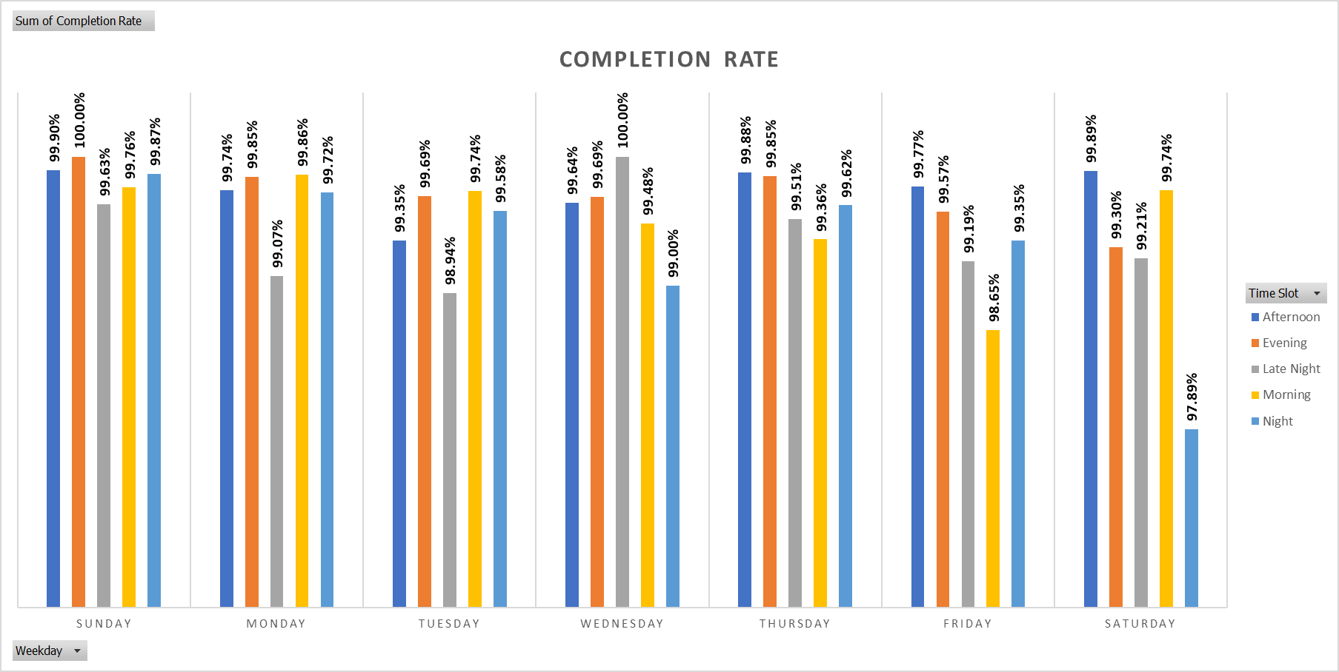
Time Slot Vs Day of the Week

Slide 10
Drop Area Analysis
Areas | Completion Rate
Bellandur, ETV | 50.00%
Domlur, EGL | 75.00%
Indiranagar | 87.50%
Marathahalli | 66.67%
Whitefield | 0.00%
Multiple areas (e.g., Akshaya Nagar, JP Nagar) have 100% completion rates. Which shows the strong performance of company in the areas.

Slide 11
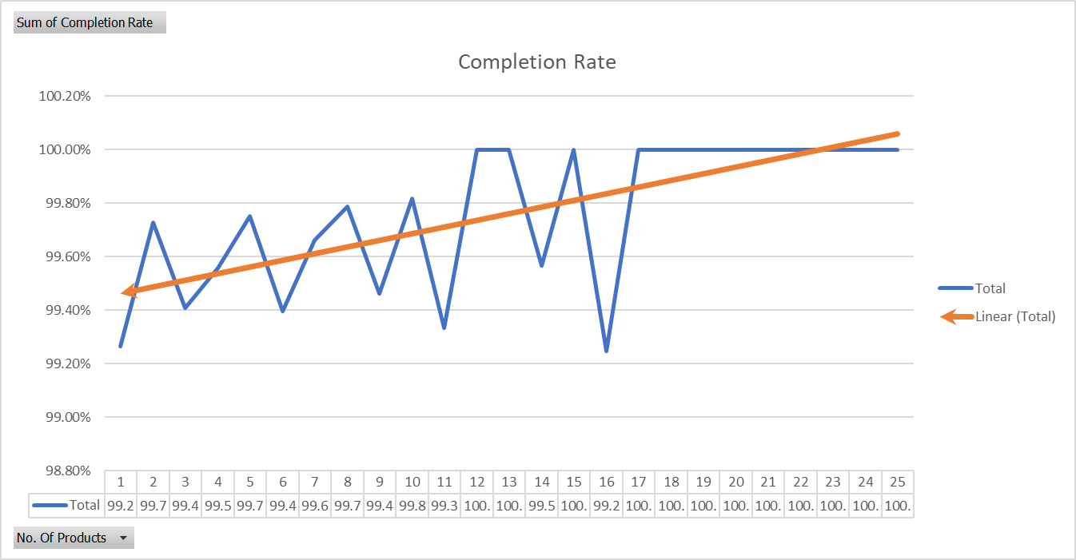
Order Size Vs Completion Rate

Slide 12


Customer Level Analysis

Slide 13
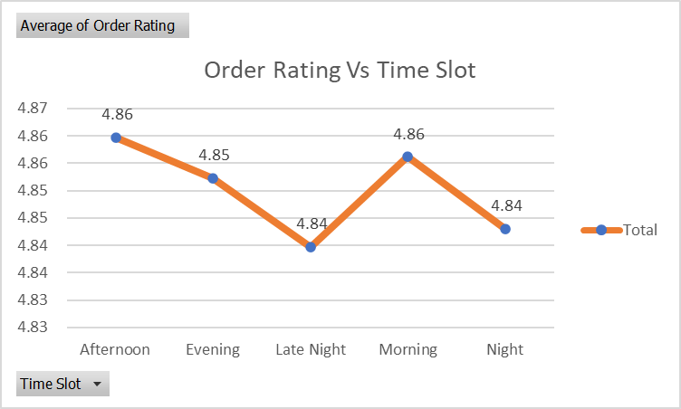
Order Ratings by Time Slot
Afternoon & Morning: Highest average ratings at 4.86.
Late Night & Night: Slightly lower ratings at 4.84.

Slide 14
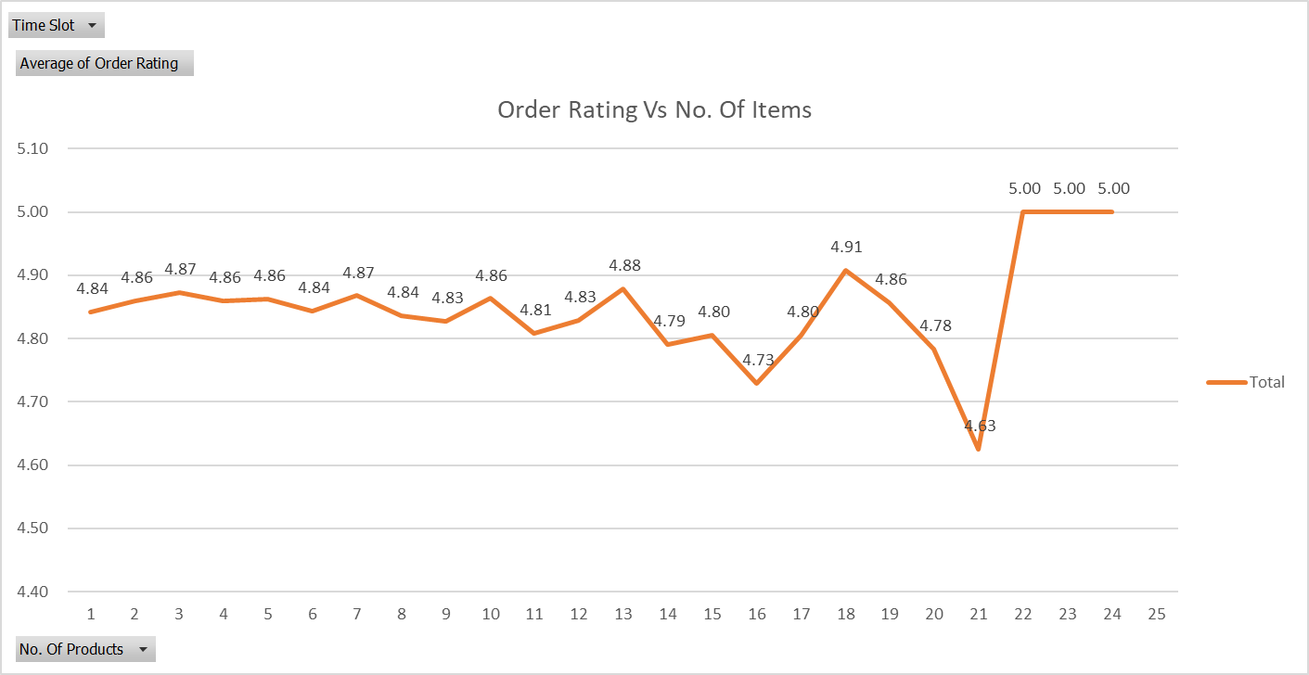
Order Ratings by Number of Items Placed
3-7 items: High ratings, peaking at 4.87.
18-24 items: Perfect ratings, suggesting a strong correlation between larger orders and satisfaction.

Slide 15
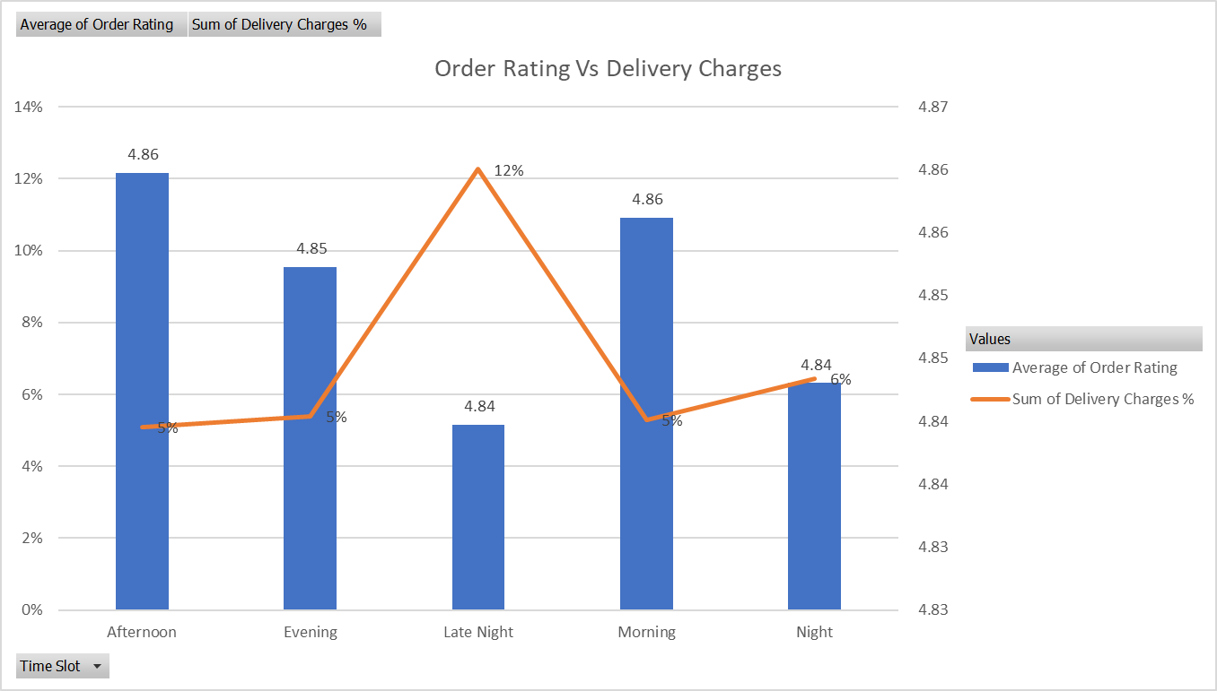
Delivery Charges Impact on Ratings
Slight inverse relationship between delivery charges and order ratings

Slide 16
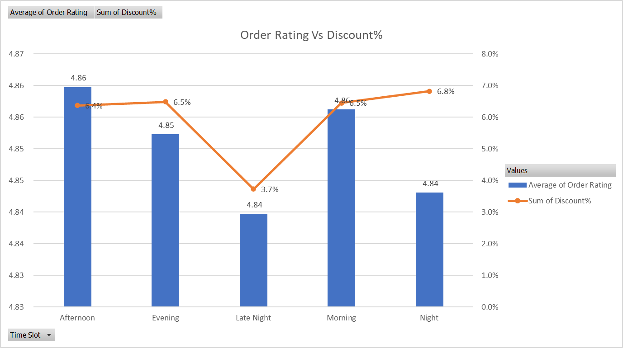
Discount Percentage vs. Order Ratings
Moderate discounts tend to be more effective in maintaining high customer satisfaction.

Slide 17
Delivery Level Analysis

Slide 18
Delivery Charges Vs Slot and Area
Areas | Afternoon | Evening | Late Night | Morning | Night | Grand Total
Akshaya Nagar | 123.33 | 116.25 | 140.75 | 133.67 | 76.25 | 119.29
Arekere | 150.00 | 100.00 | 136.00 |  | 120.00 | 127.00
Bannerghatta |  | 147.50 |  | 105.00 | 77.50 | 111.00
Basavanagudi |  | 157.50 |  |  | 150.00 | 155.00
Bellandur, Ecospace |  |  | 39.00 |  |  | 39.00
Brookefield |  |  | 332.00 |  |  | 332.00
HSR Layout | 17.11 | 17.74 | 24.64 | 17.57 | 18.51 | 18.13
Indiranagar | 85.00 |  | 192.00 | 135.00 | 110.00 | 124.25
ITI Layout | 15.18 | 15.40 | 24.36 | 14.99 | 17.72 | 16.59
JP Nagar Phase 1-3 |  | 77.50 | 179.00 | 105.00 | 90.00 | 105.80
JP Nagar Phase 4-5 | 120.00 | 100.00 | 78.00 | 152.50 | 100.00 | 117.57
JP Nagar Phase 6-7 | 125.00 |  | 199.00 | 92.50 |  | 126.50
Kudlu | 30.15 | 29.03 | 49.26 | 30.64 | 30.60 | 32.22
Grand Total | 17.28 | 17.90 | 26.85 | 17.72 | 18.85 | 18.52

Slide 19
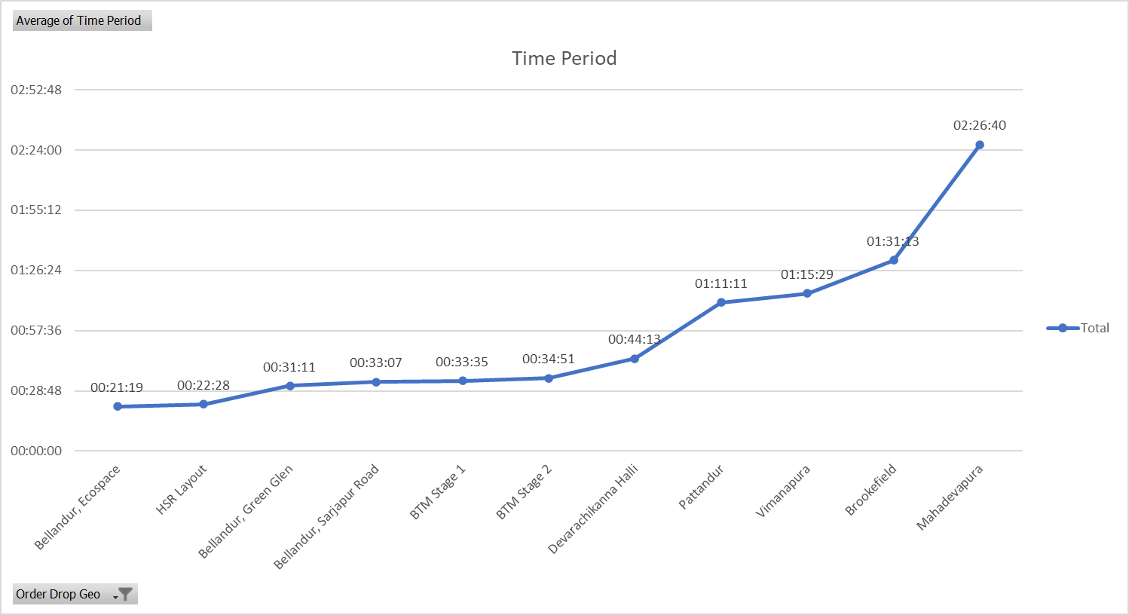
Time Period Vs Area
Patterns and Logical Reasons are mentioned in the next slide

Slide 20
Logical Reasons & Patterns
Traffic and Distance: Areas with longer delivery times and higher charges are likely farther from the distribution center or suffer from severe traffic congestion.
1
Proximity to Hubs: Areas near delivery hubs or within corporate zones have lower delivery charges and shorter times due to streamlined logistics.
2
Areas with High Demand: Places like Brookefield (01:31:13) and Indiranagar (00:50:31) have longer delivery times, despite being relatively central.
3
Infrastructure and Connectivity: Well-connected areas with good infrastructure tend to have faster delivery times, regardless of their demand levels.
4

Slide 21
Correlation b/w Delivery Charges & Time Period
Lower Charges and Shorter Times:
Areas like Bellandur Ecospace and HSR Layout exhibit both lower delivery charges and shorter times, suggesting efficient logistics in these areas.
Row Labels | Average of Time Period | Average of Delivery Charges
HSR Layout | 00:22:28 | 18.13
Bellandur, Ecospace | 00:21:19 | 39.00
Vimanapura | 01:15:29 | 210.00
Brookefield | 01:31:13 | 332.00
Higher Charges and Longer Times:
Areas like Brookfield and Vimanapura, with high delivery charges, also have long delivery times, indicating that both cost and time are influenced by similar factors like distance and traffic conditions.

Slide 22
Thank you
Vipul Jain
(Data Analyst Student)
SkilloVilla
vipul.jain14301@gmail.com

